Slide 1
TDL Project Review
Team Number : 16
Team name : Gru’s Minions
Team Members : M P Deepti - PES2UG21CS259
Marada Likitha - PES2UG21CS282
Nikitha V - PES2UG21CS338
Harshitha S - PES2UG21CS912

Slide 2
Outline
Problem Statement
Dataset
Literature Review
Model Proposed
Architecture
Output Screenshots
Evaluation metrics
Results

Slide 3
Problem Statement
Comment Toxicity Model using Deep Learning
The goal of this project is to develop a deep learning model that can automatically detect and classify toxic comments in online comments. Toxic comments include those that are disrespectful,inflammatory,or offensive in nature. By identifying and flagging these comments, online platforms can improve the quality of discussions and create safer environments for users.

Slide 4
Dataset
The dataset that we are using is the “jigsaw-toxic-comment-classification-challenge” from Kaggle.
It has a large number of Wikipedia comments which have been labeled by human raters for toxic behavior. The types of toxicity are:
toxic
severe_toxic
obscene
threat
insult
identity_hate
The dataset is in csv format and has 1,59,572 rows and 8 columns (id, comment_text, toxic, severe_toxic, obscene, threat, insult, identity_hate).

Slide 5
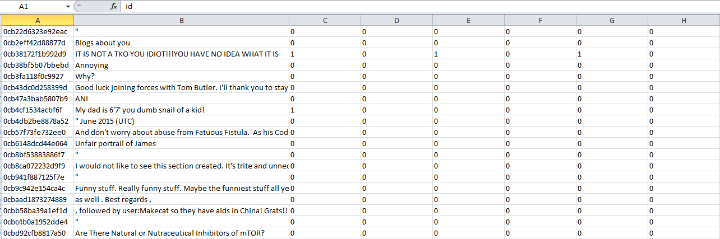
Dataset
For our model, we split 60% of this dataset for training, 20% for validation and remaining 20% is used for testing.

Slide 6
Literature Review
BERT and fastText Embeddings for Automatic Detection of Toxic Speech
Authors: Ashwin Geet D’Sa, Irina Illina, Dominique Foh
Year: 2020, Publisher: IEEE
Objective: Automatic classification of toxic speech using embedding representations of words and deep-learning techniques.
Dataset: Twitter dataset. The dataset was collected based on keywords from hatebase.org lexicon and contained annotations performed by CrowdFlower
Proposed methodology:
Convolutional Neural Network (CNN): CNNs were utilized for capturing local patterns in text, making them effective for tasks like toxic speech classification .
Bidirectional Long Short-Term Memory (Bi-LSTM): Bi-LSTMs, a type of recurrent neural network (RNN) model, were used to overcome the vanishing gradient problem and capture long-range dependencies in sequential data
These models were integrated with the BERT and fastText embeddings
Accuracy:
For binary classification, the Bi-LSTM classifier achieved the best performance with a macro-average F1-measure of 0.945 using BERT fine-tuning, while the CNN classifier achieved a macro-average F1-measure of 0.942 using fastText embeddings .
For multi-class classification, the Bi-LSTM classifier achieved the best performance with a macro-average F1-measure of 0.838 using BERT fine-tuning, while the CNN classifier achieved a macro-average F1-measure of 0.835 using fastText embeddings

Slide 7
Literature Review
Abusive Language Detection on Social Media using Bidirectional Long-Short Term Memory
Author: Ali Salehgohari, Annamaria Varkonyi Koczy, Mina Mirhosseini, Hamed Tabrizchi
Year: 2022, Publisher: 26th IEEE INES
Objective: Develop a deep learning approach to categorize comments on social media networks into specific categories such as severe toxic, toxic, obscene, insult, threat, and identity hatred.
Dataset: Wikipedia Discussion Pages Dataset. Developed by Jigsaw and Google, it comprises modifications to Wikipedia's discussion pages. Training set: 159,571 rows, Test set: 153,164 rows.
Proposed methodology:
Bidirectional Long Short-Term Memory (Bi-LSTM): Implemented to extract hidden relationships between input characteristics and the target, utilizing memory cells to recall long-term historical data and manage it using a door mechanism, thus providing benefits in analyzing and forecasting time series data. It comprises cells with three gates - output, input, and forget gates - and integrates both forward and backward time series data to better anticipate sequences.
Accuracy:
The model achieved an average accuracy of 98.383%,
F-score of 98.771,
Area Under the Curve (AUC) of 98.852 on the test data.

Slide 8
Literature Review
Li, Hao, Weiquan Mao, and Hanyuan Liu. "Toxic comment detection and classification." In CS299 Machine Learning. Standford University, 2019.
Objective:Implemented three models Naive Bayes, Logistic Regression and BiLSTM to detect toxic comments with high accuracy.Investigated two deep learning models LSTM and BERT.
Dataset: Civil Comments dataset from Kaggle, which includes a general toxic target score from 0 to 1 for each comment.
Proposed methodology:
Naive Bayes SVM model - They combined Naive Bayes and Support Vector Machines to serve as our baseline model. SVM is built over NB log-count ratios in feature values, and it has been proven a strong and robust performer over all the presented tasks.
BiLSTM model - Used word embeddings and dropout for robustness, while also predicting auxiliary scores like "obscenity" ,"identity attack," "insult,","threat" alongside toxicity scores to leverage additional information in the training data.
BERT- We used the pre-trained BERT-Base model with 12 layers, 768 hidden units, and 110M parameters. Cased version preserved true case and accent markers. For sentence classification, we added a final classification layer with weights W and computed label probabilities P using a softmax layer.
Accuracy: The Naive Bayes SVM baseline model achieved an F1 score of 68.33% and an EM score of 87.57%, while the best performing single model (LSTM or BERT) attained an F1 score of 81.19% and an EM score of 95.54%.

Slide 9
Literature Review
Taleb, Mohammed, Alami Hamza, Mohamed Zouitni, Nabil Burmani, Said Lafkiar, and Noureddine En-Nahnahi. "Detection of toxicity in social media based on Natural Language Processing methods." In 2022 International Conference on Intelligent Systems and Computer Vision (ISCV), pp. 1-7. IEEE, 2022.
Objective: This study aims to detect and classify toxic comments using various classifiers and NLP techniques to maintain a constructive and respectful virtual environment
Dataset: The dataset used is "Toxic Comment Classification Challenge" from kaggle and contains a total of 159,571 instances with comments and corresponding multiple labels, including toxic, severe toxic, obscene, threat, insult, and identity hate. The dataset focuses on the two columns "Comment text" and "toxic" for binary classification of comments.
Proposed methodology:
The proposed methodology involves two main parts. The first part focuses on determining a reliable classifier for comment classification, while the second part involves detecting toxic parts by explaining the predictions of the classifier defined in the first part.The models used were logistic regression, Naïve Bayes, Random Forest, and XGBoost models with Bag of Words and TF-IDF vectoring for binary classification. Ensemble methods were also employed. Deep learning models like CNN, LSTM, and GRU with various text representations were implemented. BERT was used for comment classification. The LIME algorithm helped in detecting toxic spans.
Accuracy: The Naive Bayes and SVM achieved an accuracy of 87.57%, while LSTM with Adam optimizer and BERT attained 95.54% accuracy. Ensemble methods improved accuracy to 95.14%. LSTM with GloVe and FastText Embeddings achieved accuracies of 98%, while GRU with GloVe and FastText Embeddings reached 93% accuracy.

Slide 10
Model Proposed
The proposed model is a Bidirectional GRU (Gated Recurrent Unit) with pooling, which is designed for text classification tasks like toxic comment detection.
It consists of an embedding layer using GLoVe (glove.840B.300d) to convert text into dense vectors, followed by a bidirectional GRU layer to capture context from both directions. The model also includes a convolutional layer for feature extraction, and global average and max pooling layers for aggregation. Finally, a dense layer with sigmoid activation is used to output the probability of toxicity for each comment.
The model is trained using the Adam optimizer and binary cross-entropy loss function. We have also incorporated techniques such as spatial dropout and batch normalization to improve the model's performance and prevent overfitting.
Toxicity score is calculated by taking an average of all 6 classes and normalized.

Slide 11
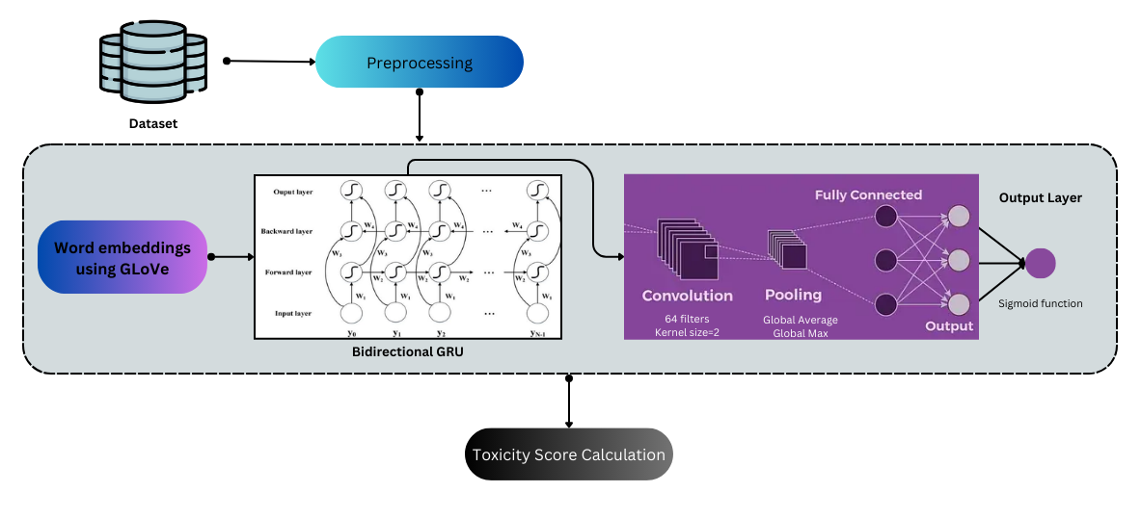
Architecture

Slide 12
Model Proposed
Justification for chosen model:
Sequence Modeling: GRUs are effective in capturing dependencies in sequential data, making them suitable for text data like comments where the order of words matters.
Bidirectional Processing: By processing the input sequence in both forward and backward directions, the model can better capture contextual information from surrounding words, which is important for tasks like toxic comment detection.
Pooling Layers: Global pooling layers (such as GlobalMaxPooling1D and GlobalAveragePooling1D) help reduce the dimensionality of the output sequence while retaining important information, aiding in classification tasks.
Efficiency: GRUs are computationally efficient compared to LSTMs, making them suitable for training on CPU.

Slide 13
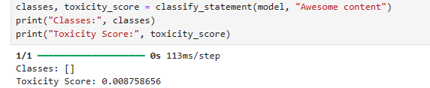
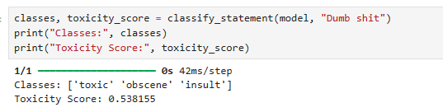
Output Screenshots
Non-toxic comment:
Insulting comment:

Slide 14
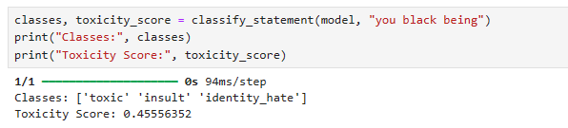
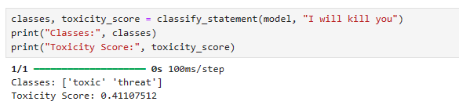
Output Screenshots
Racist comment:
Threatening comments:

Slide 15
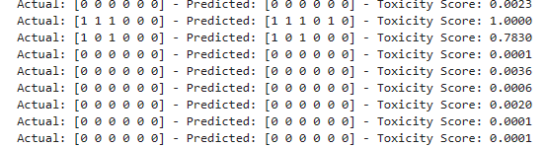
Output Screenshots
Actual data, predicted data and corresponding toxicity score:

Slide 16
Evaluation Metrics
Accuracy: Accuracy is a measure of the overall correctness of the model. It is calculated as the number of correct predictions divided by the total number of predictions.
Precision: Precision is the proportion of true positive predictions (correctly predicted positives) to the total number of positive predictions (both true positives and false positives). It measures the model's ability to correctly identify positive samples without misclassifying negative samples as positive.
Recall (Sensitivity or True Positive Rate): Recall is the proportion of true positive predictions to the total number of actual positive samples in the dataset. It measures the model's ability to correctly identify all positive samples, including those that were incorrectly classified as negative (false negatives).
F1 Score: The F1 score is the harmonic mean of precision and recall. It provides a single metric that balances both precision and recall. The F1 score reaches its best value at 1 (perfect precision and recall) and its worst at 0.

Slide 17
Results
For the test data from the train-validation-test split (60-20-20), we achieved an accuracy of 98.28 %, a precision of 0.808, recall of 0.7 and F1-score of 0.75.
For the external test dataset containing 1,59,000 rows, we achieved an accuracy of 97.7%. This was used to test the credibility of the model on new unseen data.
Overall, we can conclude that the model is performing well in classifying toxic comments. Although, there is room for improving recall and F1-score.

Slide 18
Thank You

